Slide 1
Software Quality Assurance
/
Software Quality Engineering
Lecture 10
Naseer Ahmed

Slide 2
Testing Documentation
Types of test document: Test case:
Test case review process
Traceability Matrix
Traceability matrix is a table type document that is used in the development of software application to trace requirements. It can be used for both forward (from Requirements to Design or Coding) and backward (from Coding to Requirements) tracing. It is also known as Requirement Traceability Matrix (RTM) or Cross Reference Matrix (CRM).
It is prepared before the test execution process to make sure that every requirement is covered in the form of a Test case so that we don't miss out any testing. In the RTM document, we map all the requirements and corresponding test cases to ensure that we have written all the test cases for each condition.

Slide 3
Testing Documentation
Types of test document: Test case:
Test case review process
Traceability Matrix
The test engineer will prepare RTM for their respective assign modules, and then it will be sent to the Test Lead. The Test Lead will go repository to check whether the Test Case is there or not and finally Test Lead consolidate and prepare one necessary RTM document.

Slide 4
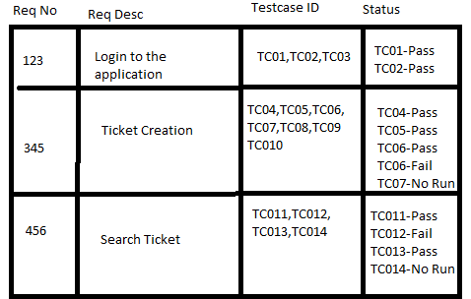
Testing Documentation
Types of test document: Test case:
Test case review process: Traceability Matrix
Which Parameters to include in Requirement Traceability Matrix?
Requirement ID
Requirement Type and Description
Test Cases with Status

Slide 5
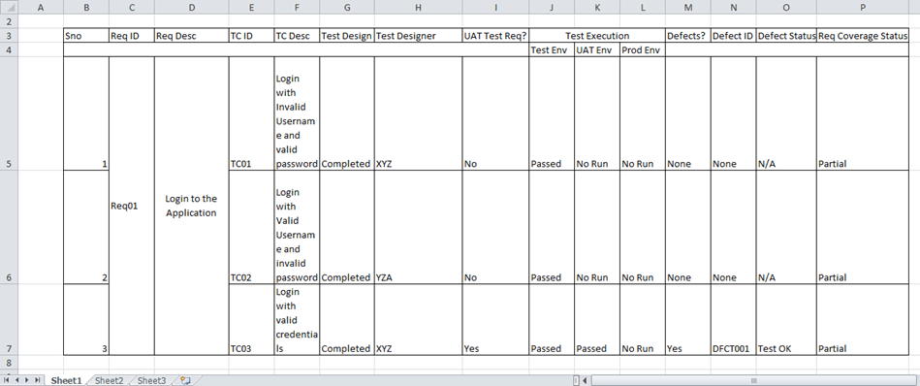
Testing Documentation
Types of test document: Test case:
Test case review process: Traceability Matrix
Which Parameters to include in Requirement Traceability Matrix?
A typical software testing project, the traceability matrix would have more than these parameters.

Slide 6
Testing Documentation
Types of test document: Test case:
Test case review process: Traceability Matrix
Goals of Traceability Matrix:
It helps in tracing the documents that are developed during various phases of SDLC.
It ensures that the software completely meets the customer's requirements.
It helps in detecting the root cause of any bug.
Types of Traceability Test Matrix:
The traceability matrix can be classified into three different types which are as follows:
Forward traceability
Backward or reverse traceability
Bi-directional traceability

Slide 7
Testing Documentation
Types of test document: Test case:
Test case review process: Traceability Matrix
Types of Traceability Test Matrix:
Forward traceability: This matrix is used to check whether the project progresses in the desired direction and for the right product. It makes sure that each requirement is applied to the product and that each requirement is tested thoroughly. It maps requirements to test cases.
Backward or reverse traceability: It is used to ensure whether the current product remains on the right track. The purpose behind this type of traceability is to verify that we are not expanding the scope of the project by adding code, design elements, test or other work that is not specified in the requirements. It maps test cases to requirements.

Slide 8
Testing Documentation
Types of test document: Test case:
Test case review process: Traceability Matrix
Types of Traceability Test Matrix:
Bi-directional traceability ( Forward + Backward):
This traceability matrix ensures that all requirements are covered by test cases. It analyzes the impact of a change in requirements affected by the Defect in a work product and vice versa.

Slide 9
Testing Documentation
Types of test document: Test case:
Test case review process: Traceability Matrix
Types of Traceability Test Matrix:
Bi-directional traceability ( Forward + Backward):
This traceability matrix ensures that all requirements are covered by test cases. It analyzes the impact of a change in requirements affected by the Defect in a work product and vice versa.

Slide 10
Testing Documentation
Types of test document: Test case:
Test case review process: Traceability Matrix
How to create Requirement Traceability Matrix:
Let's understand the concept of Requirement Traceability Matrix through a banking project.
On the basis of the Business Requirement Document (BRD) and Technical Requirement Document (TRD), testers start writing test cases.
Let suppose, the following table is our Business Requirement Document or BRD for banking project.

Slide 11
Testing Documentation
Types of test document: Test case:
Test case review process: Traceability Matrix
How to create Requirement Traceability Matrix:
Here the scenario is that the customer should be able to login to banking website with the correct password and user#id while manager should be able to login to the website through customer login page.

Slide 12
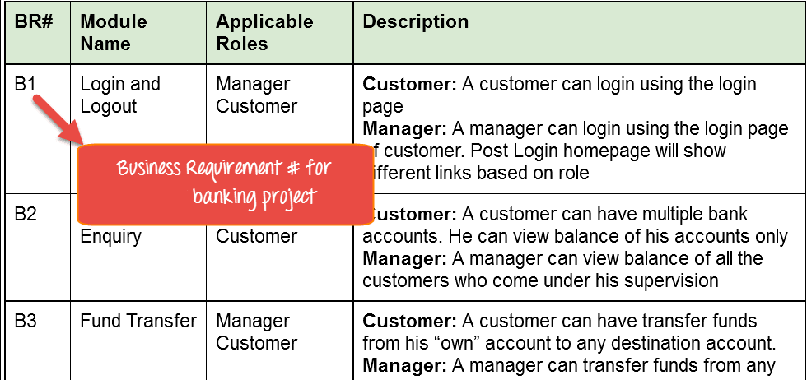
Testing Documentation
Types of test document: Test case:
Test case review process: Traceability Matrix
How to create Requirement Traceability Matrix:

Slide 13
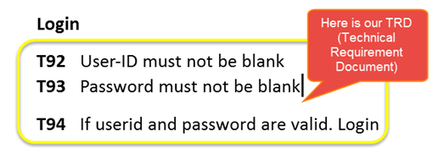
Testing Documentation
Types of test document: Test case:
Test case review process: Traceability Matrix
How to create Requirement Traceability Matrix:
While the below table is our Technical Requirement Document (TRD).
Note: QA teams do not document the BRD and TRD. Also, some companies use Function Requirement Documents (FRD) which are similar to Technical Requirement Document but the process of creating Traceability Matrix remains the same.
Let's Go Ahead and create RTM in Testing

Slide 14
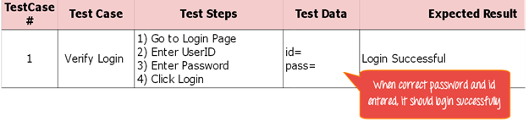
Testing Documentation
Types of test document: Test case:
Test case review process: Traceability Matrix
How to create Requirement Traceability Matrix:
Step 1: Our sample Test Case is
"Verify Login, when correct ID and Password is entered, it should log in successfully"

Slide 15
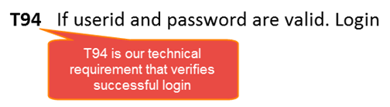
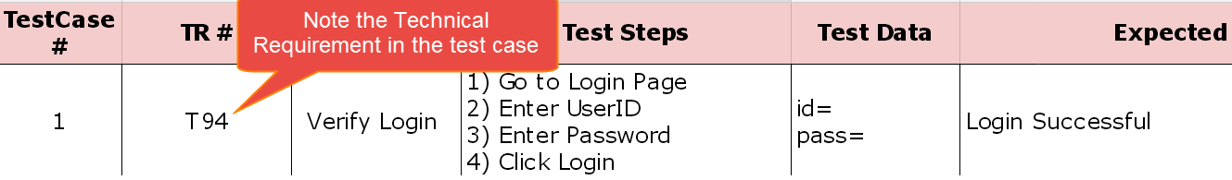
Testing Documentation
Types of test document: Test case:
Test case review process: Traceability Matrix
How to create Requirement Traceability Matrix:
Step 2: Identify the Technical Requirement that this test case is verifying. For our test case, the technical requirement is T94 is being verified.
Step 3: Note this Technical Requirement (T94) in the Test Case.

Slide 16
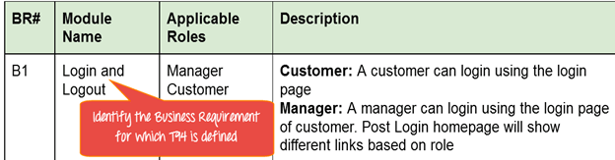
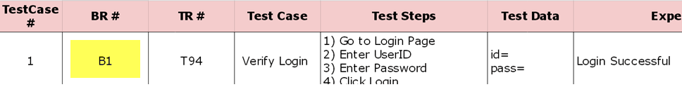
Testing Documentation
Types of test document: Test case:
Test case review process: Traceability Matrix
How to create Requirement Traceability Matrix:
Step 4:Identify the Business Requirement for which this TR (Technical Requirement-T94) is defined
Step 5: Note the BR (Business Requirement) in Test Case

Slide 17
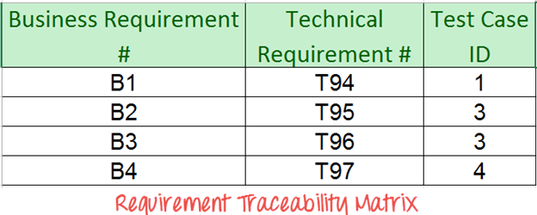
Testing Documentation
Types of test document: Test case:
Test case review process: Traceability Matrix
How to create Requirement Traceability Matrix:
Step 6: Do above for all Test Cases. Later Extract the First 3 Columns from your Test Suite. RTM in testing is Ready!

Slide 18
Testing Documentation
Types of test document: Test case:
Test case review process: Traceability Matrix
Advantage of RTM:
Following are the benefits of requirement traceability matrix:
With the help of the RTM document, we can display the complete test execution and bugs status based on requirements.
It is used to show the missing requirements or conflicts in documents.
In this, we can ensure the complete test coverage, which means all the modules are tested.
It will also consider the efforts of the testing teamwork towards reworking or reconsidering on the test cases.

Slide 19
Testing Documentation
Types of test document:
Test Plan:
A test plan is a detailed document which describes software testing areas and activities. It outlines the test strategy, objectives, test schedule, required resources (human resources, software, and hardware), test estimation and test deliverables.
The test plan is a base of every software's testing. It is the most crucial activity which ensures availability of all the lists of planned activities in an appropriate sequence.
The test plan is a template for conducting software testing activities as a defined process that is fully monitored and controlled by the testing manager. The test plan is prepared by the Test Lead (60%), Test Manager(20%), and by the test engineer(20%).

Slide 20
Testing Documentation
Types of test document: Test Plan:
Types of Test Plan:
Master Test Plan
Master Test Plan is a type of test plan that has multiple levels of testing. It includes a complete test strategy.
Phase Test Plan
A phase test plan is a type of test plan that addresses any one phase of the testing strategy. For example, a list of tools, a list of test cases, etc.
Specific Test Plans
Specific test plan designed for major types of testing like security testing, load testing, performance testing, etc. In other words, a specific test plan designed for non-functional testing.

Slide 21
Testing Documentation
Types of test document: Test Plan:
How to write a Test Plan?
Making a test plan is the most crucial task of the test management process. According to IEEE 829, follow the following seven steps to prepare a test plan.
First, analyze product structure and architecture.
Now design the test strategy.
Define all the test objectives.
Define the testing area.
Define all the useable resources.
Schedule all activities in an appropriate manner.
Determine all the Test Deliverables.

Slide 22
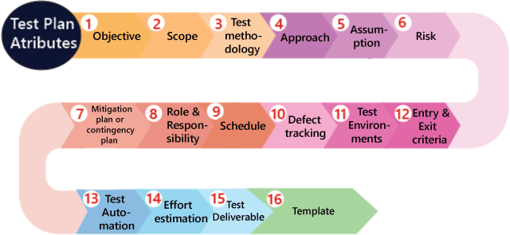
Testing Documentation
Types of test document: Test Plan:
Test plan components or attributes:
The test plan consists of various parts, which help us to derive the entire testing activity.

Slide 23
Testing Documentation
Types of test document: Test Plan:
Test plan components or attributes:
Objectives: It consists of information about modules, features, test data etc., which indicate the aim of the application means the application behavior, goal, etc.
Scope: It contains information that needs to be tested with respective of an application. The Scope can be further divided into two parts:
In scope
Out scope
In scope: These are the modules that need to be tested rigorously (in-detail).

Slide 24
Testing Documentation
Types of test document: Test Plan:
Test plan components or attributes:
Objectives: It consists of information about modules, features, test data etc., which indicate the aim of the application means the application behavior, goal, etc.
Scope: It contains information that needs to be tested with respective of an application. The Scope can be further divided into two parts:
In scope
Out scope
In scope: These are the modules that need to be tested rigorously (in-detail).
Out scope: These are the modules, which need not be tested rigorously.

Slide 25
Testing Documentation
Types of test document: Test Plan:
Test plan components or attributes:
Test methodology:
It contains information about performing a different kind of testing like Functional testing, Integration testing, and System testing, etc. on the application. In this, we will decide what type of testing; we will perform on the various features based on the application requirement. And here, we should also define that what kind of testing we will use in the testing methodologies so that everyone, like the management, the development team, and the testing team can understand easily because the testing terms are not standard.

Slide 26
Testing Documentation
Types of test document: Test Plan:
Test plan components or attributes:
Approach:
This attribute is used to describe the flow of the application while performing testing and for the future reference.
We can understand the flow of the application with the help of below aspects:
By writing the high-level scenarios
By writing the flow graph

Slide 27
Testing Documentation
Types of test document: Test Plan:
Test plan components or attributes:
Approach:
By writing the high-level scenarios:
For example, suppose we are testing the Gmail application:
Login to Gmail- sends an email and check whether it is in the Sent Items page
Login to …….
……
…....
We are writing this to describe the approaches which have to be taken for testing the product and only for the critical features where we will write the high-level scenarios. Here, we will not be focusing on covering all the scenarios because it can be decided by the particular test engineer that which features have to be tested or not.

Slide 28
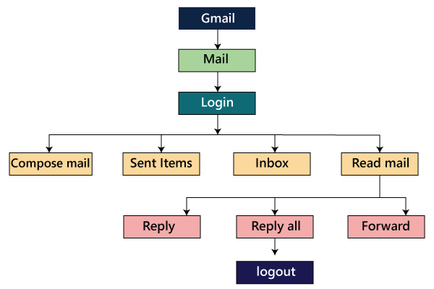
Testing Documentation
Types of test document: Test Plan:
Test plan components or attributes:
Approach:
By writing the flow graph
The flow graph is written because writing the high-level scenarios are bit time taking process, as we can see in the below image:

Slide 29
Testing Documentation
Types of test document: Test Plan:
Test plan components or attributes:
Assumption
It contains information about a problem or issue which maybe occurred during the testing process and when we are writing the test plans, the assured assumptions would be made like resources and technologies, etc.
Risk
These are the challenges which we need to face to test the application in the current release and if the assumptions will fail then the risks are involved.
For example, the effect for an application, release date becomes postponed.

Slide 30
Testing Documentation
Types of test document: Test Plan:
Test plan components or attributes:
Mitigation Plan or Contingency Plan
It is a back-up plan which is prepared to overcome the risks or issues.
The assumptions, risk, and mitigation or contingency plan are always precise on the product itself. The various types of risks are as follows:
Customer perspective
Resource approach
Technical opinion

Slide 31
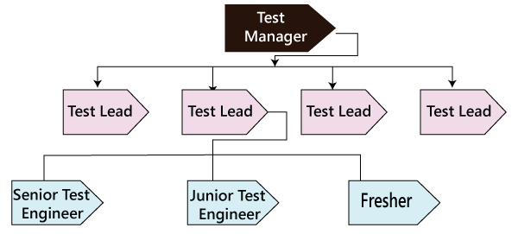
Testing Documentation
Types of test document: Test Plan:
Test plan components or attributes:
Role & Responsibility:
It defines the complete task which needs to be performed by the entire testing team. When a large project comes, then the Test Manager is a person who writes the test plan. If there are 3-4 small projects, then the test manager will assign each project to each Test Lead. And then, the test lead writes the test plan for the project, which he/she is assigned.

Slide 32
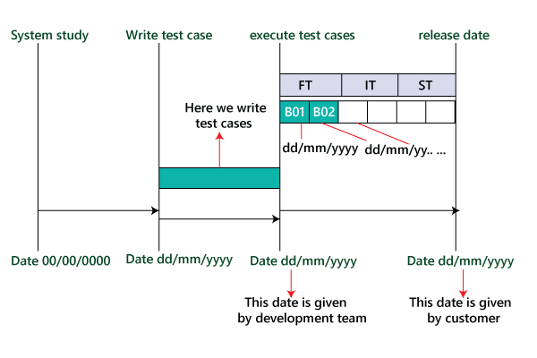
Testing Documentation
Types of test document: Test Plan:
Test plan components or attributes:
Schedule:
It is used to explain the timing to work, which needs to be done or this attribute covers when exactly each testing activity should start and end? And the exact data is also mentioned for every testing activity for the particular date.

Slide 33
Testing Documentation
Types of test document: Test Plan:
Test plan components or attributes:
Defect tracking:
It is generally done with the help of tools because we cannot track the status of each bug manually. And we also comment about how we communicate the bugs which are identified during the testing process and send it back to the development team and how the development team will reply. Here we also mention the priority of the bugs such as high, medium, and low.
Test Environments:
These are the environments where we will test the application, and here we have two types of environments, which are of software and hardware configuration.

Slide 34
Testing Documentation
Types of test document: Test Plan:
Test plan components or attributes:
Entry and Exit criteria:
It is a necessary condition, which needs to be satisfied before starting and stopping the testing process.
Entry Criteria:
The entry criteria contain the following conditions:
White box testing should be finished.
Understand and analyze the requirement and prepare the test documents or when the test documents are ready.
Test data should be ready.
Build or the application must be prepared
Modules or features need to be assigned to the different test engineers.
The necessary resource must be ready.

Slide 35
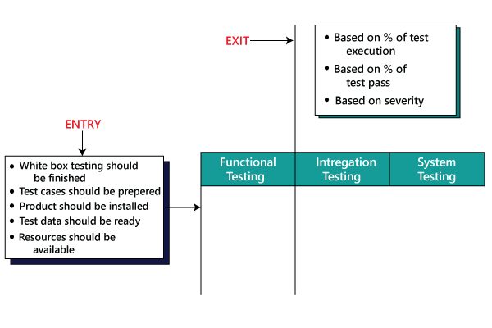
Testing Documentation
Types of test document: Test Plan:
Test plan components or attributes:
Entry and Exit criteria:
Exit Criteria
The exit criteria contain the following conditions:
When all the test cases are executed.
Most of the test cases must be passed.
Depends on severity of the bugs which means that there must not be any blocker or major bug, whereas some minor bugs exist.

Slide 36
Testing Documentation
Types of test document: Test Plan:
Test plan components or attributes:
Test Automation:
In this, we will decide the following:
Which feature has to be automated and not to be automated?
Which test automation tool we are going to use on which automation framework?
We automate the test case only after the first release.
Effort estimation:
In this, we will plan the effort need to be applied by every team member.

Slide 37
Testing Documentation
Types of test document: Test Plan:
Test plan components or attributes:
Test Deliverable:
These are the documents which are the output from the testing team, which we handed over to the customer along with the product. It includes the following:
Test plan
Test Cases
Test Scripts
RTM(Requirement Traceability Matrix)
Defect Report
Test Execution Report
Graphs and metrics
Release Notes

Slide 38
Testing Documentation
Types of test document: Test Plan:
Test plan components or attributes:
Template:
This part contains all the templates for the documents that will be used in the product, and all the test engineers will use only these templates in the project to maintain the consistency of the product. Here, we have different types of the template which are used during the entire testing process such as:
Test case template
Test case review template
RTM Template
Bug Report Template
Test execution Report

Slide 39
Testing Documentation
Types of test document:
Test strategy
The test strategy is a high-level document, which is used to verify the test types (levels) to be executed for the product and also describe that what kind of technique has to be used and which module is going to be tested. The Project Manager can approve it. It includes the multiple components such as documentation formats, objective, test processes, scope, and customer communication strategy, etc. we cannot modify the test strategy.

Slide 40
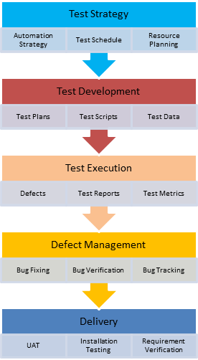
Testing Documentation
Types of test document:Test strategy
How to prepare a good test strategy document
Every organization has their unique priority and set of rules for software designing, so do not copy any organization blindly. Always ensure that their document is compatible and adds value to your software development before following the template.

Slide 41
Testing Documentation
Types of test document:
Test data
It is data that occurs before the test is executed. It is mainly used when we are implementing the test case. Mostly, we will have the test data in the Excel sheet format and entered manually while performing the test case.
The test data can be used to check the expected result, which means that when the test data is entered, the expected outcome will meet the actual result and also check the application performance by entering the in-correct input data.

Slide 42
Testing Documentation
Types of test document:
Bug report
The bug report is a document where we maintain a summary of all the bugs which occurred during the testing process. This is a crucial document for both the developers and test engineers because, with the help of bug reports, they can easily track the defects, report the bug, change the status of bugs which are fixed successfully, and also avoid their repetition in further process.

